Slide 1
Circuit Guard-PCB Defect Detection and Classification Application
Presented By: Mohammad Nousheen Tabassum

Slide 2
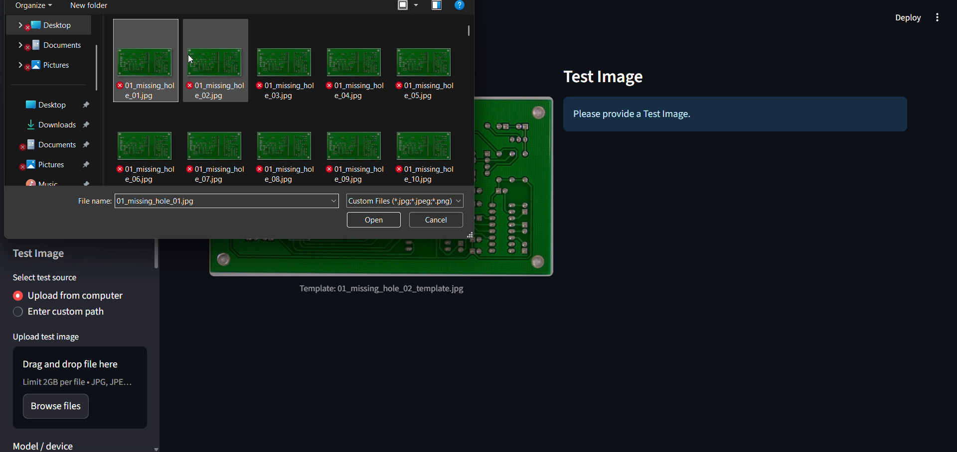
Circuit Guard-PCB Defect Detection and Classification Application

Slide 3
Introduction
Printed Circuit Boards (PCBs) are the foundational components of modern electronics. Quality assurance is paramount, as defects can lead to critical system failures, costly recalls, and manufacturing downtime. The challenge lies in the sheer volume and complexity of high-density PCBs.

Slide 4
Problem Statement
Printed Circuit Board (PCB) quality control is critical for electronics reliability. Manual visual inspection is slow, inconsistent and error-prone as component density grows. The objective of AI-Circuit Guard is to automate PCB inspection using image-processing plus a deep-learning classifier to detect and classify common PCB defects (Missing-hole, Mouse-bite, Open-circuit, Short, Spur, Spurious-copper). The system must be robust to small misalignments, lighting variation and produce clear, human-readable annotated outputs and logs.
Manual PCB inspection: slow, subjective, unreliable at scale
Need: automated, repeatable inspection with high precision & recall
Target defects: Missing-hole, Mouse-bite, Open-circuit, Short, Spur, Spurious-copper
Deliverable: web UI for uploading images + backend pipeline that outputs annotated images, ROI crops, CSV logs

Slide 5
Objective
Main Goal: To design and deploy AI Circuit Guard — an automated PCB defect detection and classification system using deep learning and computer vision.
Specific Objectives:
Accurate Defect Classification: Detect and classify common PCB defects such as Missing Hole, Mouse Bite, Open Circuit, Short, Spur, and Spurious Copper with high precision.
Efficient Model Development: Train and fine-tune an EfficientNet-B4 model for optimized inference speed and accuracy.
Modular Backend Infrastructure: Build a modular Python-based backend integrating OpenCV for preprocessing and PY-Torch for inference.
Automated Image Processing: Perform subtraction, contour extraction, ROI detection, and morphological filtering for defect localization.
Interactive Web Application: Develop a Stream-lit - based frontend allowing users to upload PCB images, visualize annotations, and download labeled results.
Performance Evaluation: Evaluate model performance using precision, recall, F1-score, and confusion matrices.

Slide 6
System Architecture .
The system follows a modular AI pipeline consisting of both frontend and backend components: Frontend (UI Layer): Built using Stream-lit. Allows image uploads, parameter tuning (morph iterations, sensitivity), and displays annotated results. Backend (Processing Layer): Handles preprocessing, alignment, subtraction, and ROI extraction using OpenCV. Runs the EfficientNet-B4 model for classification. Model Training Layer: Uses PY-Torch to train on extracted ROIs with data augmentation. Storage/Output Layer: Saves predictions, logs, and annotated outputs to organized folders

Slide 7
methodology
The pipeline is modular:
Preprocessing → alignment → subtraction & mask generation → ROI extraction → classification → annotation & logging.
Each stage is implemented as a separate function/module so the system is maintainable and easy to optimize.
Step-by-step pipeline (numbered)
Dataset pairing : generate template/test pairs (template: defect-free image; test: defective image).
Alignment : align test to template (ORB + homography) to reduce pixel misregistration.
Difference & mask : grayscale subtraction + Gaussian blur + adaptive/Otsu threshold, optionally combined with edge-difference to highlight changes.

Slide 8
methodology
Morphology & filtering : morphological open/close and connected-component filtering to remove small noise. Keep top-N blobs by area.
ROI extraction : crop bounding boxes for each defect blob and save to outputs_module6/rois.
Classification : EfficientNet-B4 predicts defect class and confidence for each ROI.
Annotation & logging : draw labels on the test image, save annotated image, save CSV predictions and append a run log (timestamp, template/test names, num_rois, labels).
Export : zip results and provide download (ROI images, annotated image, mask, predictions CSV, and inference log).

Slide 9
Model training and evaluation
We trained an EfficientNet-B4 classifier on ROIs cropped from difference masks. Images were Pre-processed to 128×128, normalized with ImageNet stats and augmented (rotations / flips). Training used PY-Torch with the Adam optimizer. The trained model is integrated into the inference backend and used to label cropped ROIs produced by the subtraction + morphology pipeline.
Key training configuration:
Framework: PY-Torch + Timm EfficientNet-B4
Input: ROI crops resized to 128 × 128
Optimizer: Adam
Learning rate: 2e-4, Batch size: 16, Epochs: 6

Slide 10
Model training and evaluation
Loss: Cross-entropy
Data: ROI images and labels extracted from dataset annotations
Evaluation & metrics :
Validation accuracy: ~92–93%; Test accuracy: ~92%
Primary metrics reported per class: Precision, Recall, F1-score
Confusion matrix to visualize inter-class confusions
Model demonstrates strong recall for most classes; occasional confusion between visually-similar defects (e.g., Spur vs Spurious-copper)

Slide 11
Conclusion
AI-Circuit Guard delivers an end-to-end, modular solution for PCB defect detection: preprocessing, mask generation, ROI extraction and Efficient NetB4-based classification integrated through a Stream-lit frontend. The system provides reproducible, logged outputs and exportable artifacts (annotated images, masks, ROIs, CSVs). With further dataset-specific tuning and additional training data, the system can be production-hardened for automatic PCB QA.
Slide bullets
Modular, maintainable pipeline with clear inputs/outputs
Achieved ~92% classification accuracy on test set
Exportable artifacts: annotated image, mask, rois, predictions CSV, inference log
UI provides easy parameter tuning to balance sensitivity vs false positives

Slide 12
Future scope
Collect more labeled samples per defect class (reduce class imbalance)
Ensemble multiple models or use segmentation models (U-Net) for per-pixel defect masks
Add a confidence threshold and “human-in-the-loop” review for low-confidence ROIs
Performance optimizations: batch ROI classification, GPU support, and ONNX export
Add user authentication, database backend and REST API for integration into QA pipelines

Slide 13
Thank you

